Slide 1

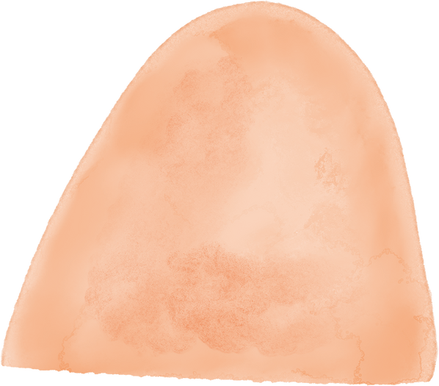
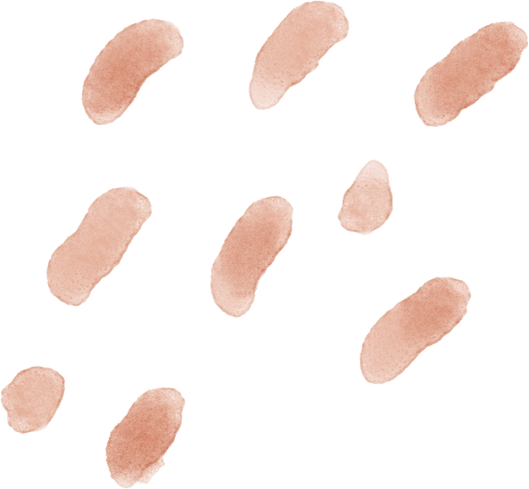


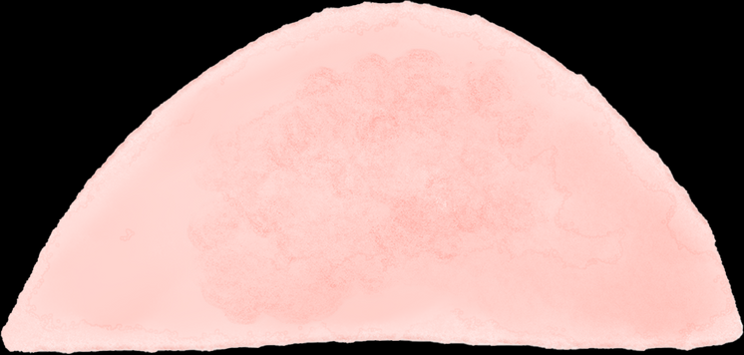

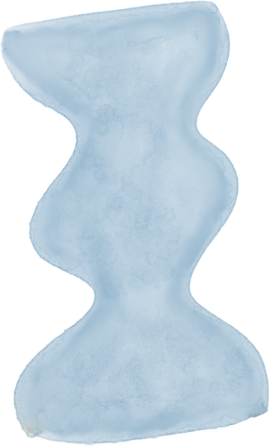
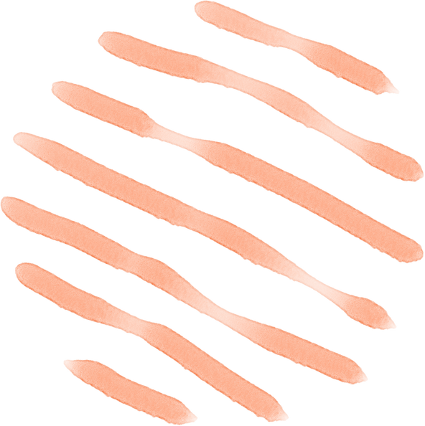


AI-POWERED PERSONAL COLOR ANALYSIS
PERSONALIZED FASHION RECOMMENDATION
Raviteja Gundu, Aaris Khan, Divya Avuti, Divya Navale

Slide 2
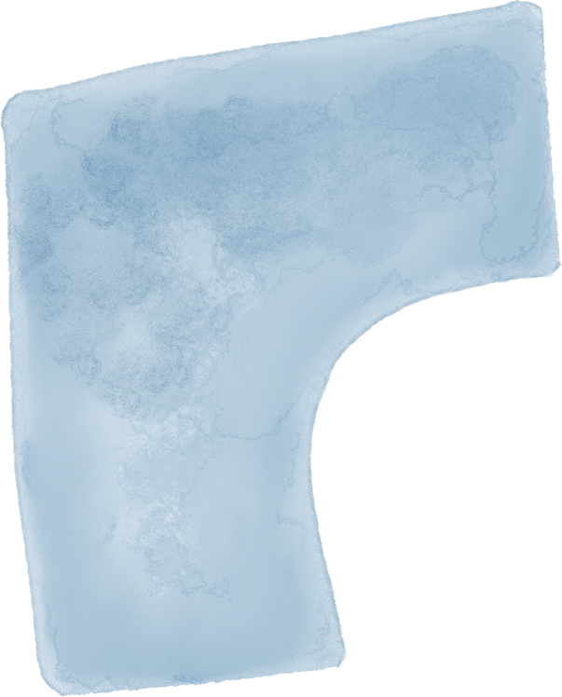
INTRODUCTION
AI-powered color analysis identifies each student’s personalized palette (warm, cool, or deep)
Matches palette with Career Closet inventory to find suitable clothing.
Recommends complete outfits to simplify professional styling decisions
Boosts confidence and saves time while providing a personalized, practical solution

Slide 3
SPONSOR
CAREER DEVELOPMENT CENTER
CAREER COUNSELOR - MELODY MONDAY

Slide 4

MUST HAVES
ML model to:
Analyze skin tone
Classify tone as warm/cold
Suggest suitable color palettes
Digital wardrobe inventory (career closet)
Interactive User Interface (UI) for seamless interaction
Model/API to:
Recommend outfits based on color palette
Match clothing items with personal tone

Slide 5
NICE TO HAVE
SIZE INCLUSION
VIRTUAL TRY-ON
EMAIL FEATURE
USER FEEDBACK SYSTEM
LIKE/DISLIKE OPTIONS ON RECOMMENDATIONS

Slide 6
FUNCTIONAL REQUIREMENTS
Accept one person per photo for analysis
Process photos of clothing items
Extract dominant colors from clothing
Display outfit suggestions

Slide 7
NON - FUNCTIONAL REQUIREMENTS
Simple and clean user experience
Fast photo and wardrobe processing
Intuitive UI flow and suggestions
High accuracy in tone detection and recommendations
Quick response time (low latency)
Secure handling of user photos and personal data

Slide 8
TASKS TO WORK
User Interface
Finding Datasets
ML model to:
Analyze skin tone
Classify tone as warm/cold
Suggest suitable color palettes

Slide 9
THANK YOU!

